Slide 1


Your Personalized Mental Health Companion
Welcome to a space dedicated to your well-being. Our AI-powered mental health assistant is designed to offer personalized support and resources, empowering you on your journey towards mental wellness.

Slide 2

Real-Time Emotional Analysis
Our intelligent system uses natural language processing to understand your mood based on your text inputs. We analyze your words, sentence structure, and even subtle cues to gauge your emotional state. This allows us to provide tailored support and resources that resonate with your needs.
1
Understanding Your Emotions
We aim to recognize patterns in your language that indicate your emotional state, such as anxiety, stress, or happiness.
2
Tailored Support
The emotional insights gained help us provide personalized recommendations and tools to support your mental well-being.
3
Open Communication
We encourage you to express yourself openly, as your words are valuable in helping us understand your current emotional state.
4
Confidentiality
Your privacy is our priority. All conversations and data are handled with the utmost confidentiality.

Slide 3

Customizable Support Plans
We believe everyone's mental health journey is unique. That's why we offer customizable support plans tailored to your individual needs. Whether you're seeking stress management techniques, coping mechanisms, or guidance on specific challenges, our AI can help create a personalized path for you.
Initial Assessment
1
We start by gathering information about your current state, goals, and preferences.
2
Personalized Plan Creation
Our AI analyzes your responses and recommends a plan with relevant resources, activities, and tools.
Ongoing Support
3
We're here to help you navigate your plan and make adjustments as needed.

Slide 4
Anonymous Peer Support
Connecting with others who share similar experiences can be incredibly empowering. Our platform facilitates anonymous peer support, allowing you to connect with individuals who understand your journey. This fosters a sense of community and shared understanding, promoting a feeling of not being alone.
Safe & Anonymous
Diverse Perspectives
Shared Understanding
You can connect with others without revealing your identity, creating a safe and comfortable space to share your experiences.
Our platform allows you to connect with people from various backgrounds, providing diverse perspectives and support.
Connecting with others who have faced similar challenges can help you feel less isolated and more understood.

Slide 5
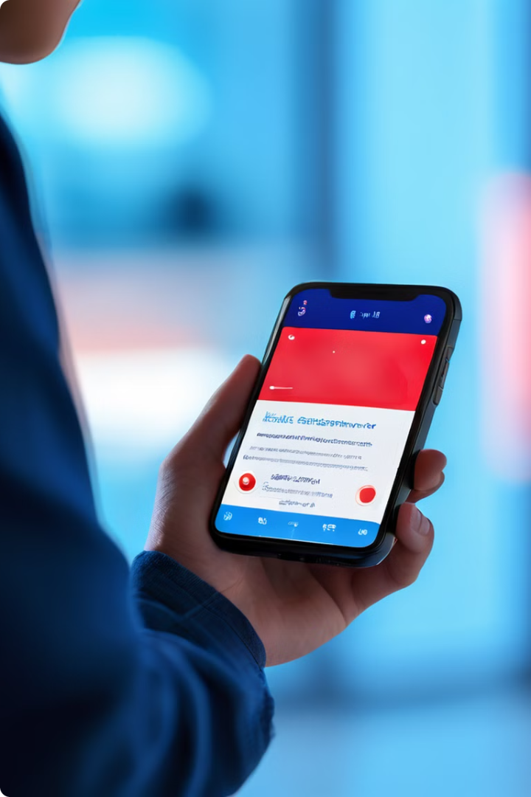



Emergency Alerts
We understand that mental health crises can happen at any time. Our system includes an emergency alert feature that can detect signs of crisis in your conversations or inputs. If a potential crisis is detected, we'll alert your designated emergency contacts or connect you with professional help immediately.
Crisis Detection
Our AI continuously analyzes your inputs for potential signs of crisis, such as suicidal ideation or self-harm.
Alerting Emergency Contacts
In case of a detected crisis, we can send alerts to your pre-selected emergency contacts, such as family, friends, or healthcare professionals.
Connecting to Help
We can also connect you directly with emergency services, such as a crisis hotline or mental health professional.

Slide 6
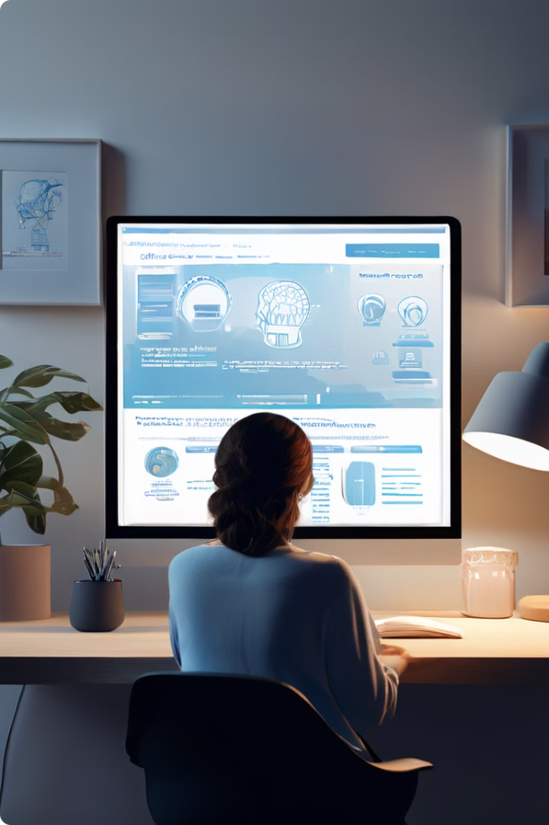
Personalized Insights and Resources
Our AI continuously gathers information from your interactions to provide personalized insights and resources. We offer access to a vast library of articles, podcasts, meditation apps, and other tools relevant to your needs and interests.
Personalized Recommendations
We recommend resources tailored to your current emotional state, goals, and preferences.
Engaging Content
We offer a variety of engaging content formats, including articles, podcasts, videos, and interactive exercises.
Continuously Updated
Our library is constantly updated with the latest information and resources in mental health.

Slide 7





Building a Positive Mental Health Routine
We aim to empower you to build healthy habits and routines that support your mental well-being. Our AI can help you track your mood, identify triggers, and develop personalized strategies for managing stress and promoting positive emotions.
Schedule Reminders
Set reminders for activities that promote your well-being, such as meditation, exercise, or journaling.
Mindfulness Practices
Learn and practice mindfulness techniques to help you stay grounded and present in the moment.
Track Progress
Monitor your progress towards your mental health goals and celebrate your achievements along the way.
Personalized Support
Receive tailored encouragement and support as you work towards building positive routines.

Slide 8

A Collaborative Approach
We believe in a collaborative approach to mental well-being. Our AI is designed to work in conjunction with your healthcare providers. We can help you track your progress, share insights with your therapist, and facilitate communication for better care.
Shared Information
You can choose to share data with your healthcare providers, empowering them to provide more personalized care.
Improved Communication
Our platform can help facilitate communication between you and your healthcare providers, ensuring a smoother and more effective care plan.
Empowering Your Journey
We're here to support you every step of the way, empowering you to take control of your mental health journey.

Slide 9
